Slide 1
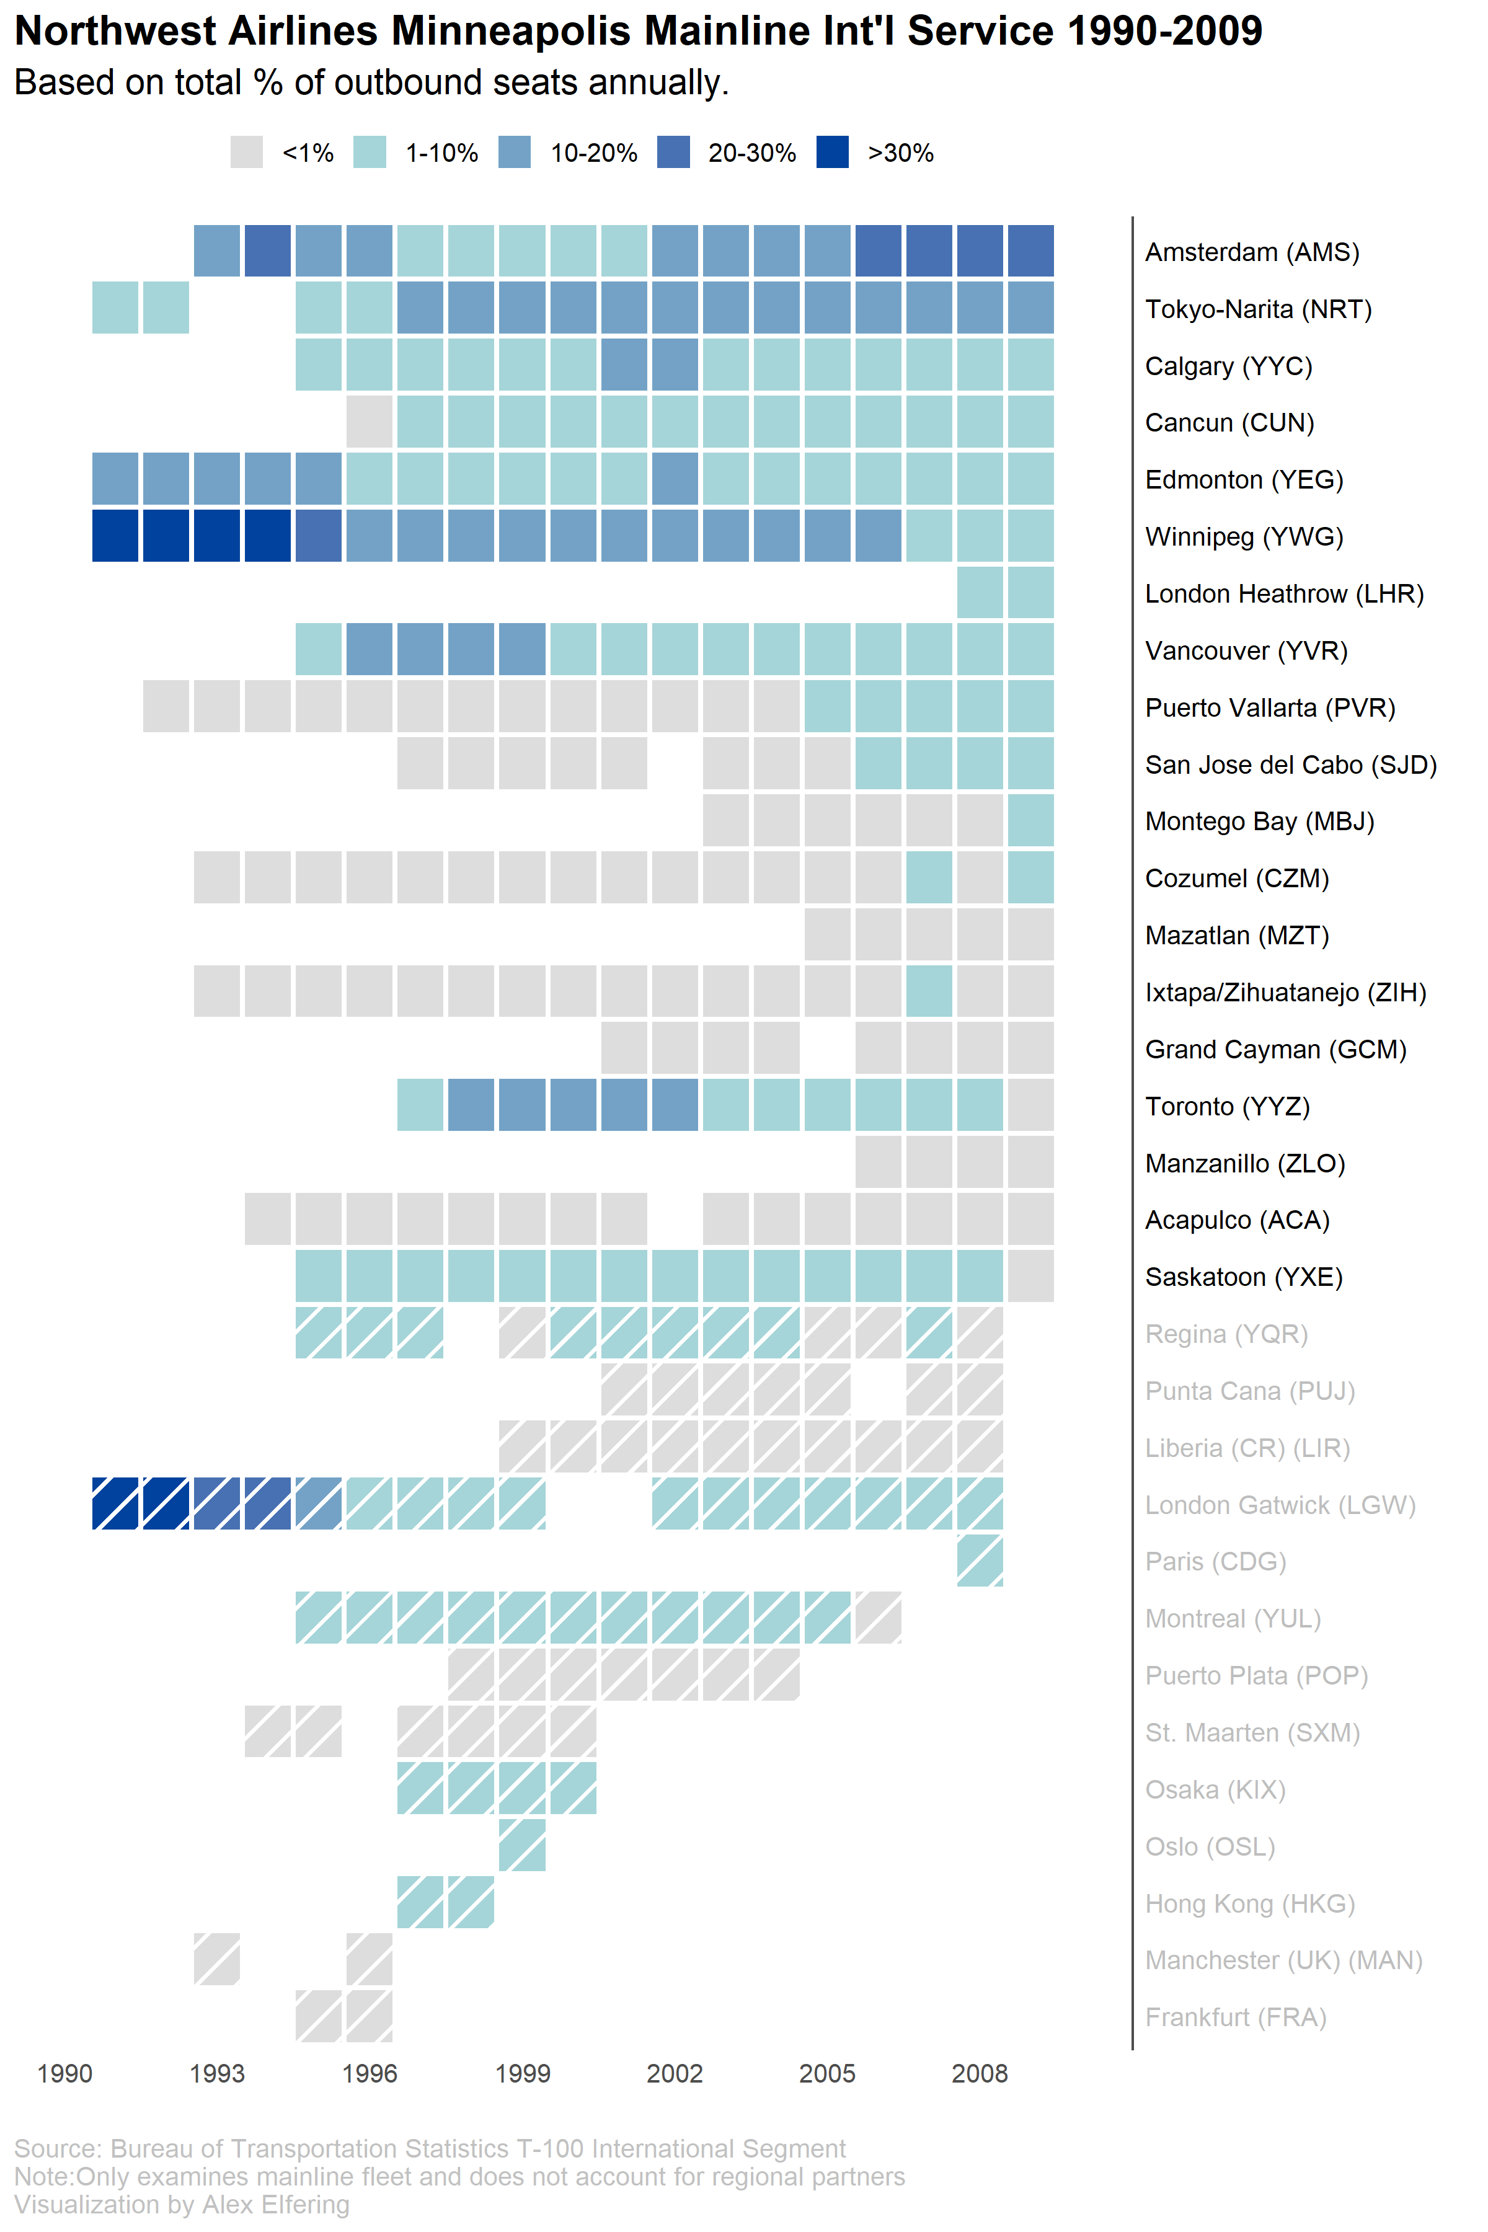
In ‘93, NW began an
alliance with Dutch-carrier KLM
to connect pax in AMS
Tokyo was an
International hub
Former
routes
Gatwick service ended
When Northwest was permitted to use Heathrow

